Slide 1
Discrete Mathematics BCSC 0010
Module 2 Validity of Arguments

Slide 2
Argument
An argument in propositional logic is a sequence of propositions.
All but the final proposition in the argument are called premises or hypotheses and the final proposition is called the conclusion.

Slide 3
Example
"If you have a current password, then you can log onto the network."
"You have a current password."
Therefore,
"You can log onto the network.“
This is an argument with two premises and a conclusion

Slide 4
Validity of Arguments
An argument is valid if the truth of all its premises implies that the conclusion is true.

Slide 5
Argument form
An argument form in propositional logic is a sequence of compound propositions involving propositional variables.
An argument form with premises p1, p2, p3, ... ,pn and conclusion q is valid, when (p1 ∧ p2 ∧ p3 ∧ ……∧ pn) → q is a tautology.
The key to showing that an argument in propositional logic is valid is to show that its argument form is valid.

Slide 6
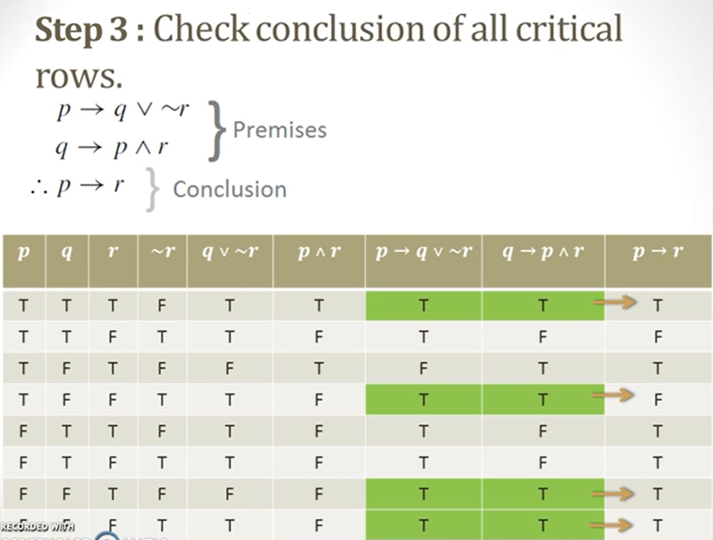
Argument form
The key to showing that an argument in propositional logic is invalid is to show that its argument form is invalid.

Slide 7
Example
If man is bachelor, he is unhappy.
If man is unhappy, he die young.
Bachelor dies young. (conclusion)
Qs: From the above premises validate the conclusion
P: A man is bachelor
q: man is unhappy
r: man dies young

Slide 8
Example
p q r (p → q) q→r (p → r)
T T T T T T
T T F T F F
T F T F T T
T F F F T F
F T T T T T
F T F T F T
F F T T T T
F F F T T T
As the all critical rows are true then the premises validated the conclusion
p → q
q → r
p → r

Slide 9
Example
Consider an argument: If you have a current password, then you can log onto the network. You have a current password.Therefore,You can log onto the network.
Argument form
Let p represents "You have a current password"
and q represents "You can log onto the network."
Then, the argument has the form

Slide 10
Rules of Inference

Slide 11
Example

Slide 12
Example

Slide 13
Using Rules of Inference to Build Arguments

Slide 14
Example
Show that the hypotheses "It is not sunny this afternoon and it is colder than yesterday," "We will go swimming only if it is sunny," "If we do not go swimming, then we will take a canoe trip," and "If we take a canoe trip, then we will be home by sunset" lead to the conclusion "We will be home by sunset.“
contd..

Slide 15
Example
Show that the hypotheses "It is not sunny this afternoon and it is colder than yesterday," "We will go swimming only if it is sunny," "If we do not go swimming, then we will take a canoe trip," and "If we take a canoe trip, then we will be home by sunset" lead to the conclusion "We will be home by sunset.“
P:It is sunny this afternoon
Q: it is colder than yesterday
R: We will go swimming
S: we will take a canoe trip
T: we will be home by sunset (conclusion)
Hypothesis :
(¬P ∧ Q), (R → P), (¬ R → S), (S → T)
contd..

Slide 16
Step1
(¬P ∧ Q) ∧ (R → P) ∧ (¬ R → S) ∧ (S → T)
¬P (simplification)
¬P ∧ (R → P) = ¬R (modus tollen)
¬R ∧ (¬ R → S) = S (modus ponen)
Step 4: S ∧ (S → T) (modus ponen)
T
Step2
Step3

Slide 17
(¬P ∧ Q) ∧ (R → P) ∧ (¬ R → S) ∧ (S → T)
¬P
Note that we could have used a truth table to show that whenever each of the four hypotheses is true, the conclusion is also true. However, because we are working with five propositional variables, p, q, r, s, and t, such a truth table would have 32 rows.

Slide 18
Example
Show that the hypotheses "If you send me an e-mail message, then I will finish writing the program," "If you do not send me an e-mail message, then I will go to sleep early," and "If I go to sleep early, then I will wake up feeling refreshed" lead to the conclusion ."If I do not finish writing the program, then I will wake up feeling refreshed. "
contd..

Slide 19
Example
Show that the hypotheses "If you send me an e-mail message, then I will finish writing the program," "If you do not send me an e-mail message, then I will go to sleep early," and "If I go to sleep early, then I will wake up feeling refreshed" lead to the conclusion ."If I do not finish writing the program, then I will wake up feeling refreshed. "
P: you send me an e-mail message
Q: I will finish writing the program
R: I will go to sleep early
S: I will wake up feeling refreshed
(conclusion)
Hypothesis :
(P → Q), (¬ P → R), (R → S), (¬Q → S )
contd..

Slide 20
(P → Q) ∧ (¬ P → R) ∧ (R → S) ∧ (¬Q → S )

Slide 21
(P → Q) ∧ (¬ P → R) ∧ (R → S) ∧ (¬Q → S )
(¬ Q → ¬P) ∧ (¬ P → R) ∧ (R → S) ∧ (¬Q → S )
(¬ Q → R) ∧ (R → S) ∧ (¬Q → S )
(¬ Q → S) ∧ (¬Q → S )
(¬Q → S )
(P → Q) ∧ ( Q → R) = (P → R)

Slide 22
Example
Show that the hypotheses "If you send me an e-mail message, then I will finish writing the program," "If you do not send me an e-mail message, then I will go to sleep early," and "If I go to sleep early, then I will wake up feeling refreshed" lead to the conclusion ."If I do not finish writing the program, then I will wake up feeling refreshed. "
contd..

Slide 23
Discrete Mathematics BCSC 0010
Module 3 Validity of Arguments
(By Resolution Principle)

Slide 24
Resolution Principle
Literal: A variable or negation of a variable
Clause : Disjunction of literals
Let us Suppose that
C1= P V Q V R
C2= ¬ P V S V T
P and ¬ P can delete and the resolvent will be disjunction of the remaining literal.
The final disjunction in the resolution rule, Q v R v S v T, is called the resolvent.

Slide 25
Argument validity by Resolution Principle
Consider an argument where p1,p2,….,pn are premises and C is the conclusion.
To prove the validity of the argument by resolution principle,
Put p1,p2…,pn in clause form and add to it ~C in clause form
From this sequence if (empty clause ) can be derived , the argument is valid

Slide 26
Example
Consider Modus Ponens
Validity Proof:
Hence the argument is valid

Slide 27
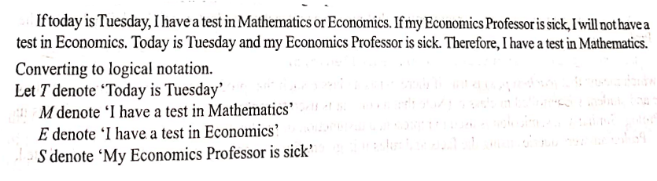
Example
contd..

Slide 28
Example
Τ → (Μ V E)
S → ¬ Ε
Τ ∧ S
contd..

Slide 29
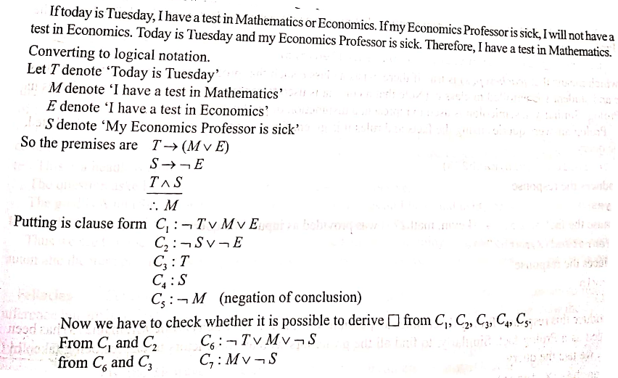
contd..

Slide 30
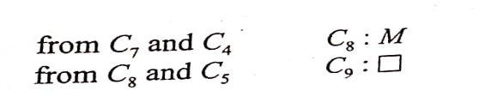
Hence the argument is valid

